Slide 1

INVESTMENT ANALYTICS
BY : DAKSHATA RABBI

Slide 2
OBJECTIVE:
An investment involves putting capital to use today in order to increase its value over time. One of the examples of investments are Foreign Direct Investments(FDI).So to minimize the risk before investing into things we always look for historic data of investment to reduce the risk of loss that may happen in future. This project focuses on analysis of FDI made in India from the year 2000 - 2017 in various sectors. The objective of the project is to perform data visualization techniques to understand the insight of the data. Users will able to make decision before making their next investment.

Slide 3
BENEFITS :
Analysis will help to understand FDI in India from 2000 – 2017.
Which sector is investable before making any next move.
Year wise analysis of each sector , which year it was at top and bottom.
Average investments made throughout.

Slide 4
DATA DESCRIPTION:
Dataset consist of Sectors and Years in which investments were made from year 2000 – 2017.
For getting the insights and to visualize it in tableau. First we analyzed the data using different features.
Data was distributed into different sheets so make charts out of it for creating a dashboard.
In the Transformation Process, we will convert our original datasets with other necessary attributes format.
Following are the features/attributes descriptions that we found out from excel so to include them in Tableau.
Sector- Wise Analysis – Consist of all sectors as row and years as columns which included the investment amount in billion (US dollars) sector wise.
Year wise Analysis – Consist of all the year and their sum of investments, year wise.

Slide 5
DATA DESCRIPTION:
Sector- Wise Analysis – Consist of all sectors as row and years as columns which included the investment amount in billion (US dollars) sector wise.
Year wise Analysis – Consist of all the year and their sum of investments, year wise.
Top 5 sectors – It consisted of the top 5 sectors in which the investments were made from the year 2000 – 2017.
Bottom 5 sectors - It consisted of the bottom 5 sectors in which the investments were made from the year 2000 – 2017.
Rising Sectors - It consisted of the sectors in which the investments found to be increased in from the year 2014 – 2017.
Highest Investments – This is text box which actually shows the sector in which highest investments were made throughout the years and its total sum.
Lowest Investments – This is text box which actually shows the sector in which lowest investments were made throughout the years and its total sum.

Slide 6
DATA INSERTION:
After creating different sheets for the attributes , we need to create chart so to include them in dashboard.
Data from excel needs to be inserted in Tableau.
After opening Tableau Public , we’ll get an option to select our data source.
After selecting the excel file , next step would be to select the sheet in which table is present to so make a creative chart out of it.

Slide 7
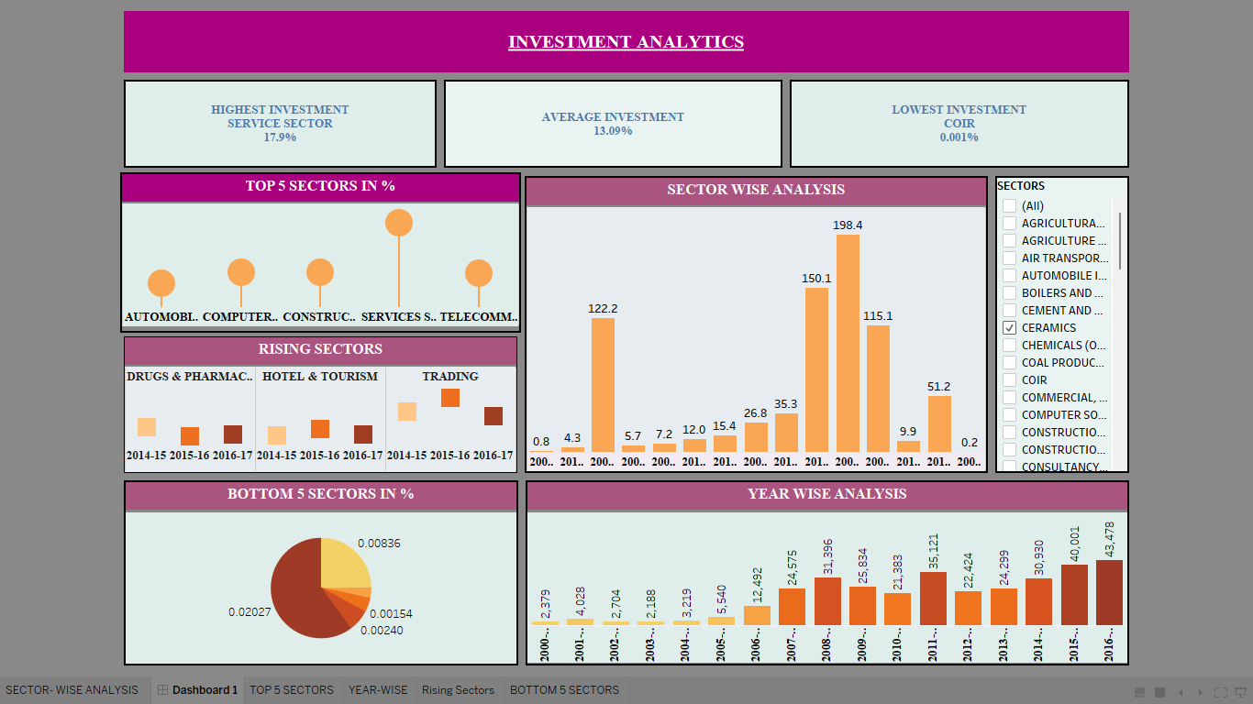
DASHBOARD USING TABLEAU:

Slide 8
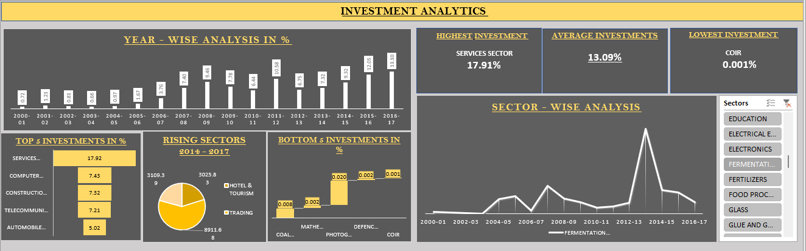
DASHBOARD USING EXCEL:

Slide 9
ANALYSIS:
Services Sector was top most sector where the highest investments were made through out year 2000 – 2017.
Coir was least invested sector from 2000 – 2017.
Top 5 sectors where FDI in India was high were : Services Sector, Automobile Industry , Telecommunication ,Computer Software and Hardware, Construction Development.
Bottom 5 sectors were : Coal Production , Coir , Mathematical Surveying and drawing instruments , Photographic film and raw paper.
Rising sectors : Sectors in which FDI’s were started are :Drugs and Pharmaceuticals , Trading & Hotel and Tourism.
Year Wise Analysis : 2008-09 , 2011 -12 , 2014 – 2015 , 2015-2016 , 2016- 2017 are the years where highest investments were made.

